Slide 1
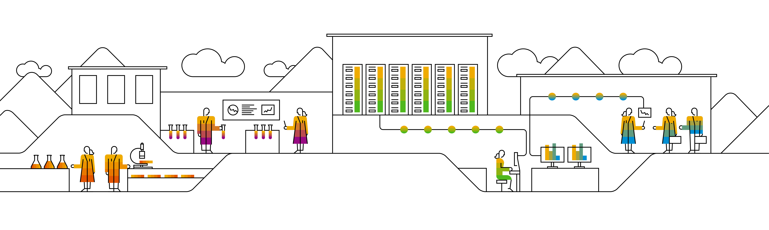
Unsupervised Learning Clustering

Slide 2
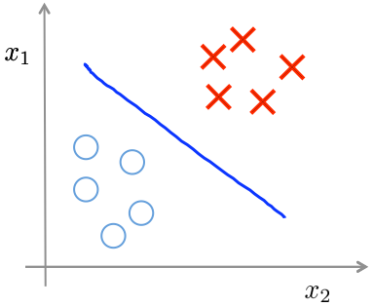
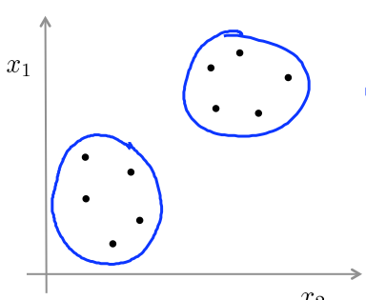
Supervised learning
Unsupervised learning

Slide 3
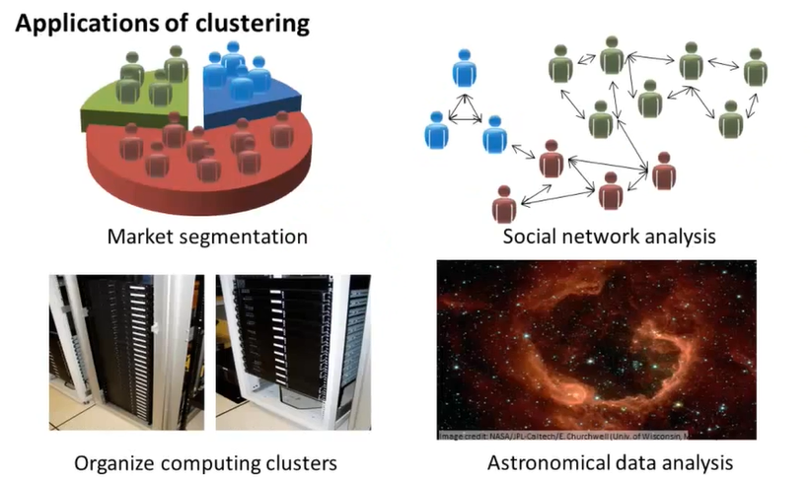
Applications of Clustering

Slide 4
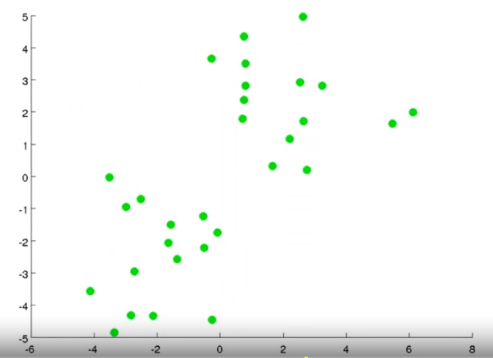
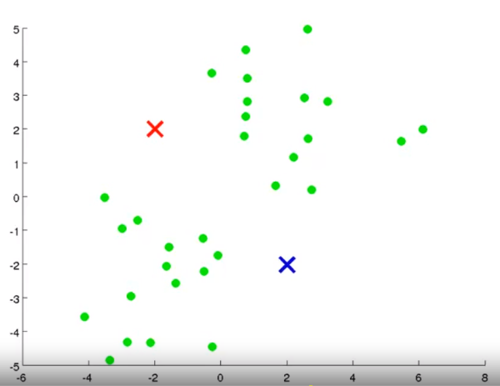
Objective Take an unlabeled dataset and group the data into clusters. Randomly assign two points, called the cluster centroids.

Slide 5
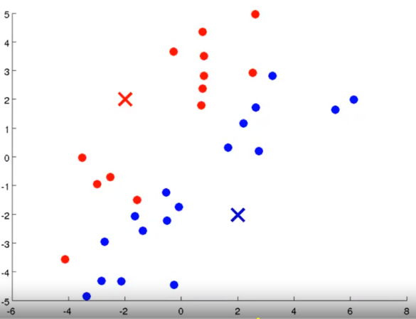
Step 1: Cluster assignment Go through the data and color each of the point either red or blue, depending on whether it is closer to the red cluster centroid or the blue cluster centroid.

Slide 6
Step 2: Move centroid Compute the mean of the red and blue points and move the respective clusters to the point.

Slide 7
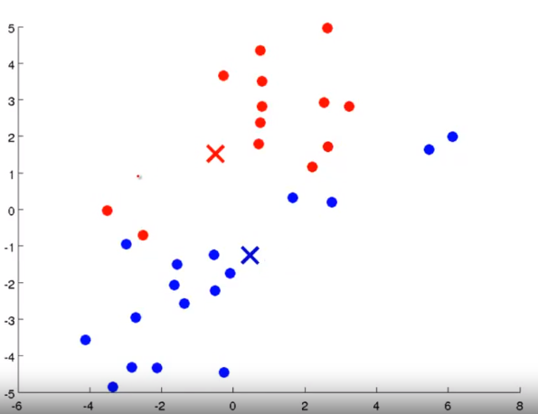
Repeat Step 1

Slide 8
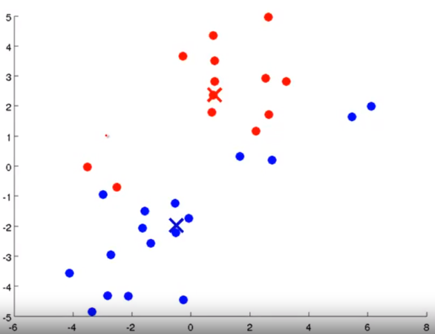
Repeat Step 2

Slide 9
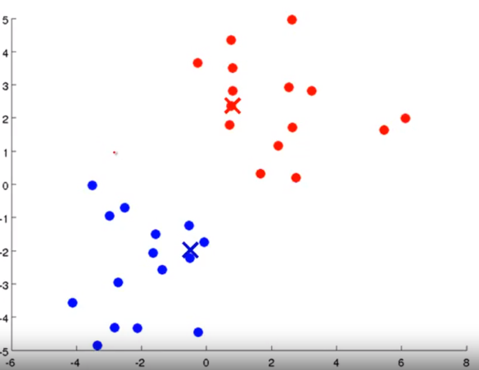
Repeat Step 1

Slide 10
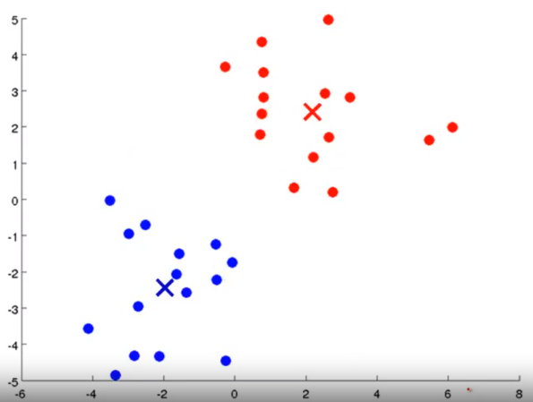
Repeat Step 2

Slide 12
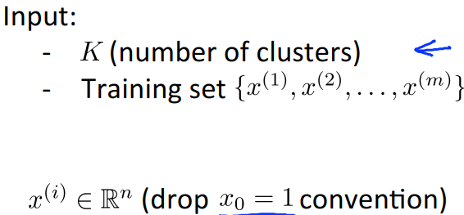

K-means algorithm

Slide 13
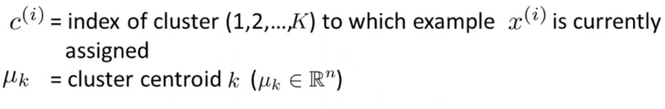
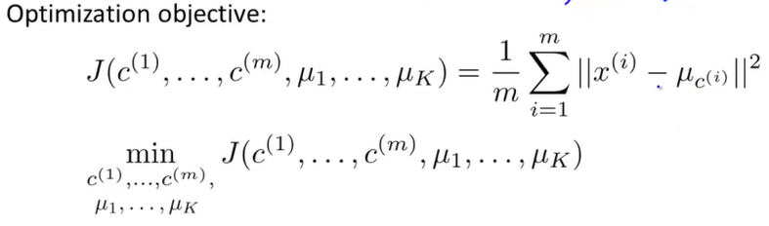
K-Means optimization objective

Slide 14
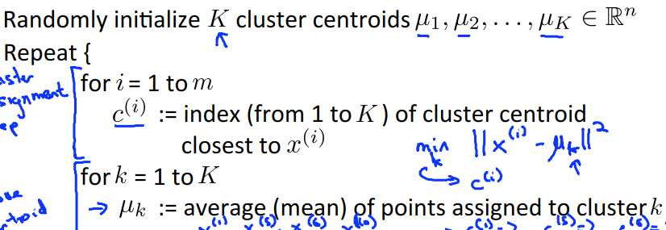





K-means algorithm
}

Slide 15
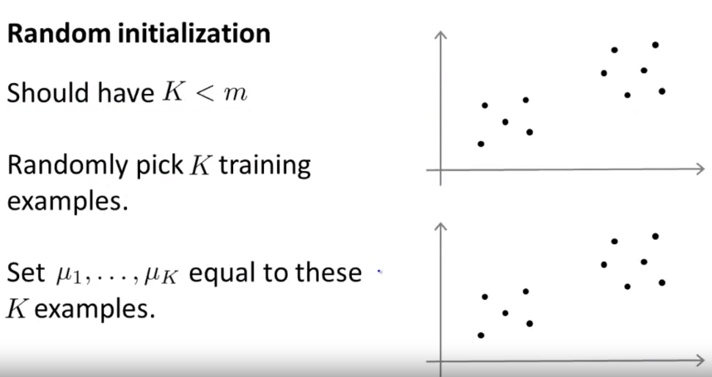
Random Initialization

Slide 16
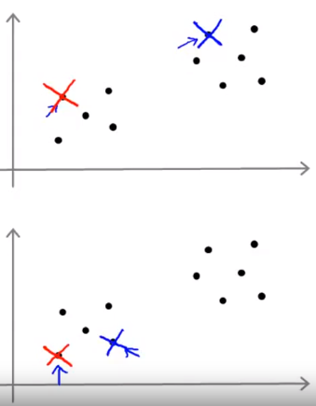
Random Initialization Example

Slide 17
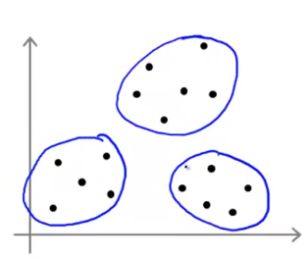
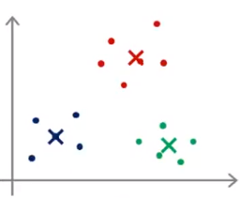
Local optima

Slide 18
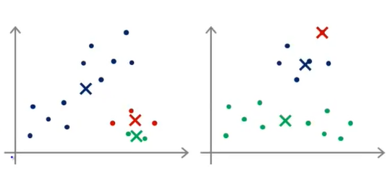

Slide 19
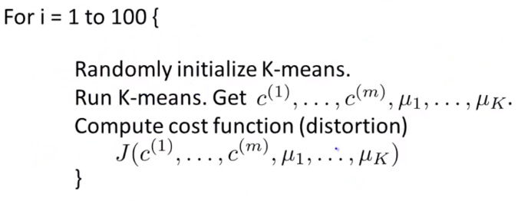
Random Initialization

Slide 20
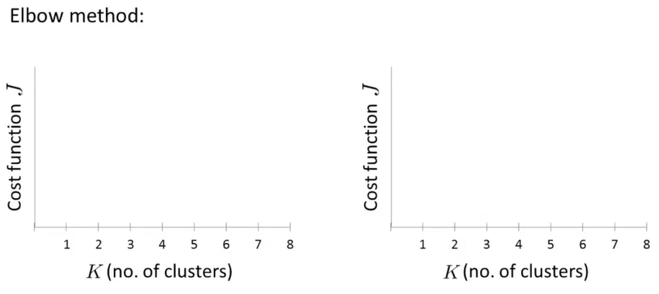
Choosing the value of K

Slide 21
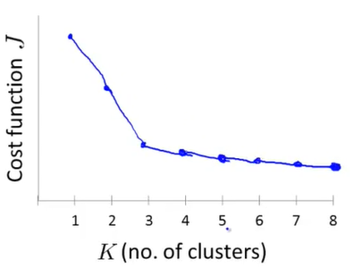
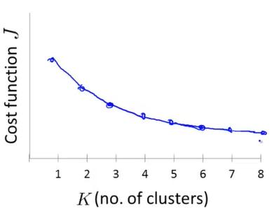

Slide 22
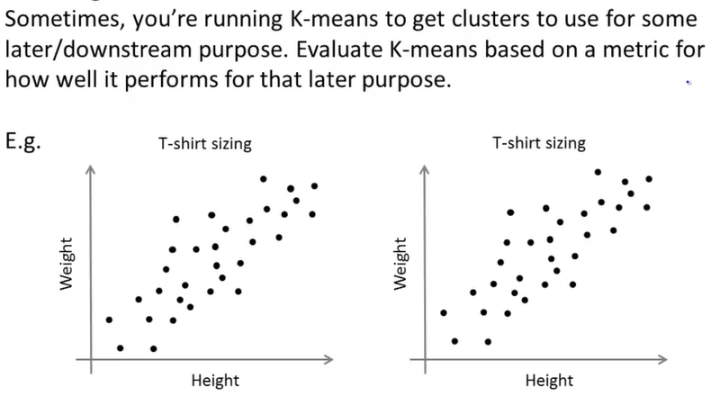
Choosing the number of K

Slide 23
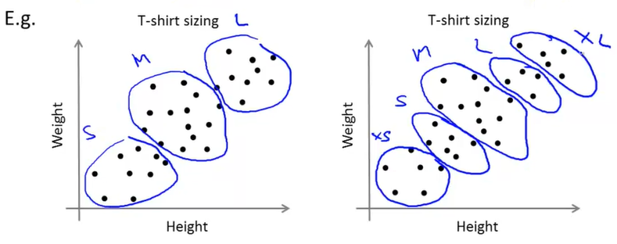

Slide 24
Thank you.

